Slide 1
Customized Topological Sort using OpenMP
Nada Aladdin Abdel-Fatah
Batool Mohammad Kayyam
With:
Dr. Fady Ghanim

Slide 2
Contents:
OpenMP
Topological Sort
Customized Topological Sort
Serial Code
Example explains topological sort
Parallel Code – First Version
Parallel Code – Second Version
Parallel Code – Third Version
Conclusion

Slide 3
OpenMP
OpenMP is a widely adopted application programming interface (API) that facilitates parallel programming in shared-memory computing environments.
OpenMP allowing developers to write parallel programs using a combination of compiler directives and runtime library routines.
OpenMP provides a simple and portable approach for exploiting parallelism in programs.

Slide 4
Topological sorting algorithm
Topological Sort orders a directed acyclic graph in a way such that each node appears before all the nodes it points to in the returned order.
Topological Sorting is mainly used for scheduling jobs from the given dependencies among jobs.

Slide 5
Customized Topological Sorting
Customized topological sort aims to perform sorting based on dependencies of nodes given. The most significant difference is about the structure of the graph, the topological sort applied on. It must be an undirected graph, which will change the way of sorting.

Slide 6
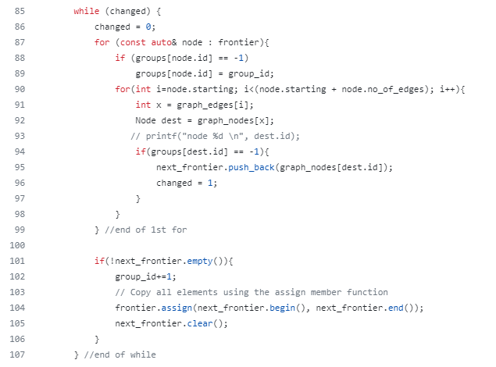
Serial Code

Slide 7
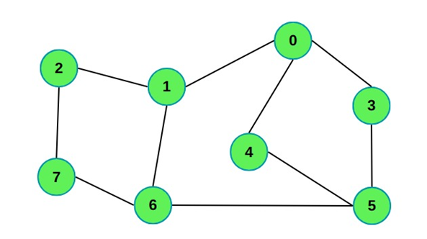
Example about topological sort

Slide 8
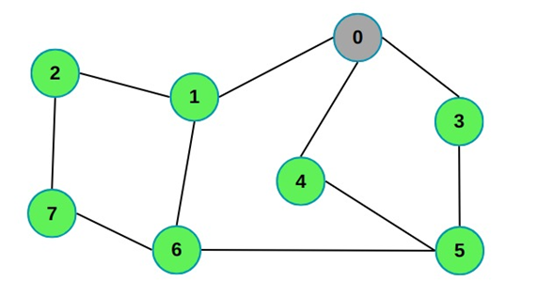
Example about topological sort – (cont.)

Slide 9
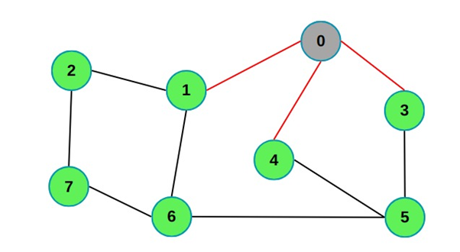
Example about topological sort – (cont.)

Slide 10
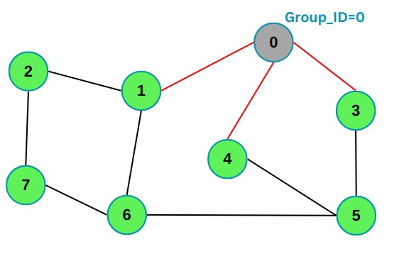
Example about topological sort – (cont.)

Slide 11
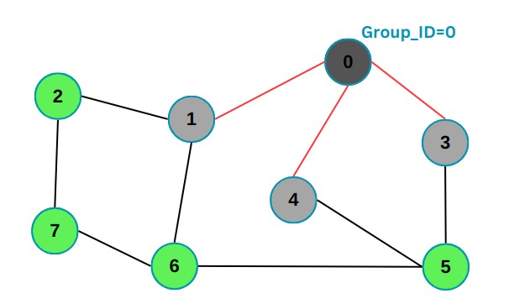
Example about topological sort – (cont.)

Slide 12
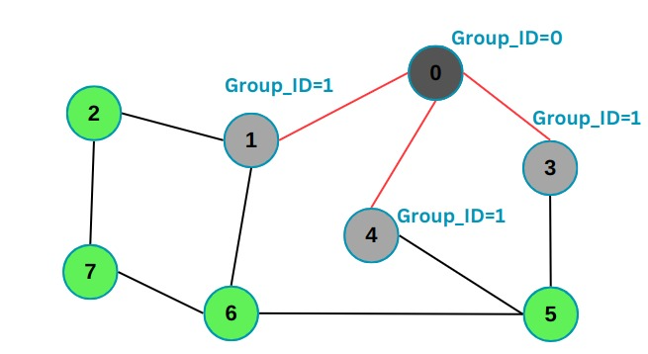
Example about topological sort – (cont.)

Slide 13
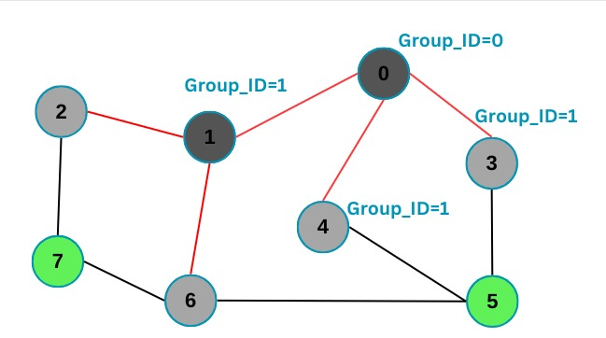
Example about topological sort – (cont.)

Slide 14
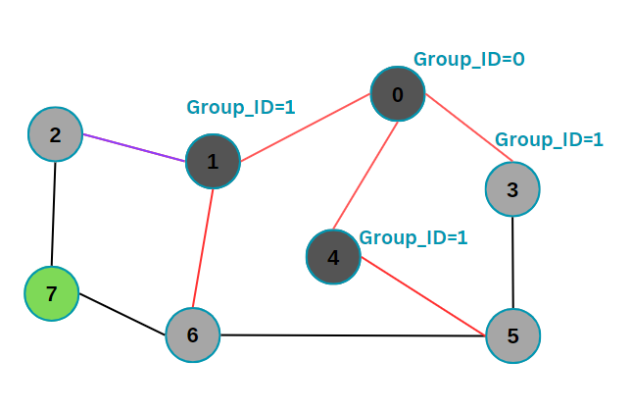
Example about topological sort – (cont.)

Slide 15
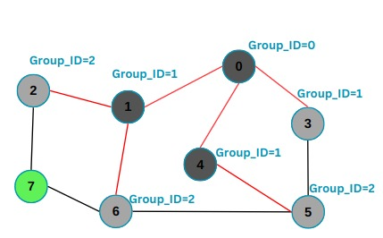
Example about topological sort – (cont.)

Slide 16
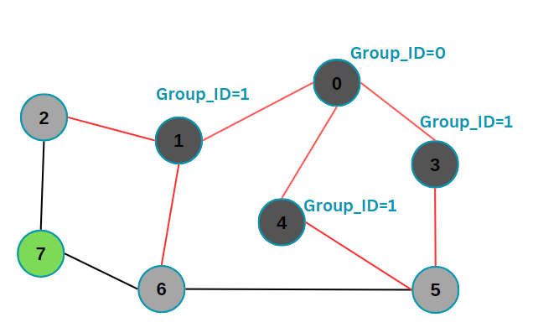
Example about topological sort – (cont.)

Slide 17
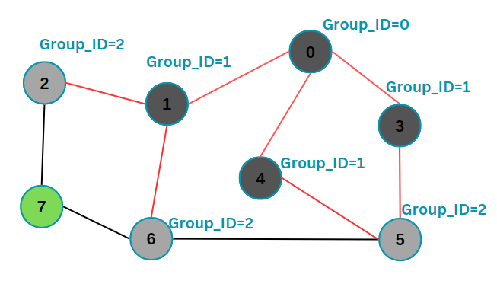
Example about topological sort – (cont.)

Slide 18
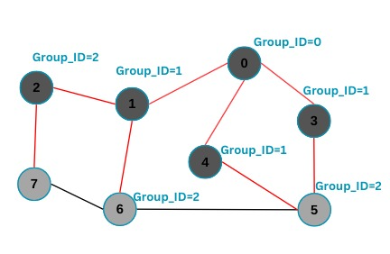
Example about topological sort – (cont.)

Slide 19
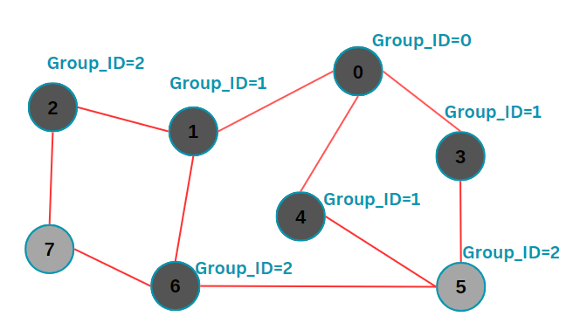
Example about topological sort – (cont.)

Slide 20
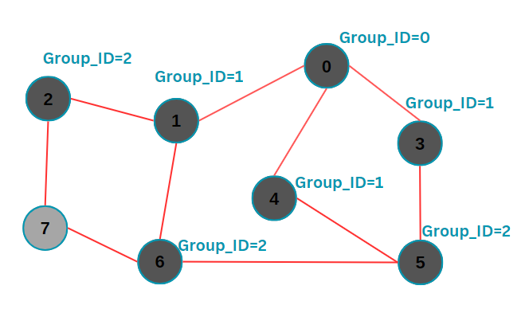
Example about topological sort – (cont.)

Slide 21
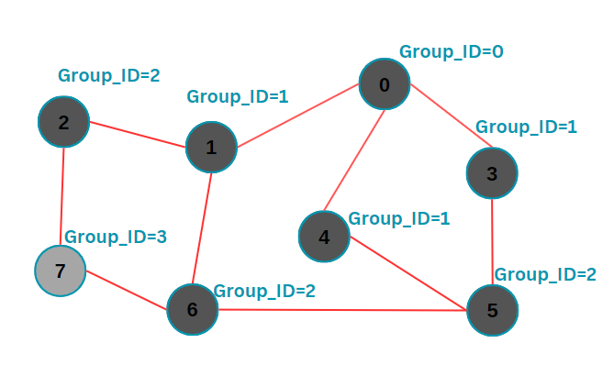
Example about topological sort – (cont.)

Slide 22
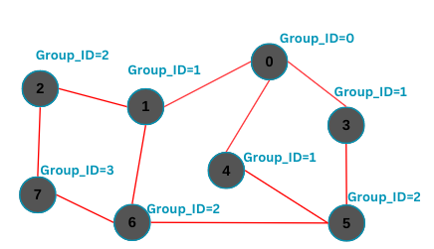
Example about topological sort – (cont.)

Slide 23
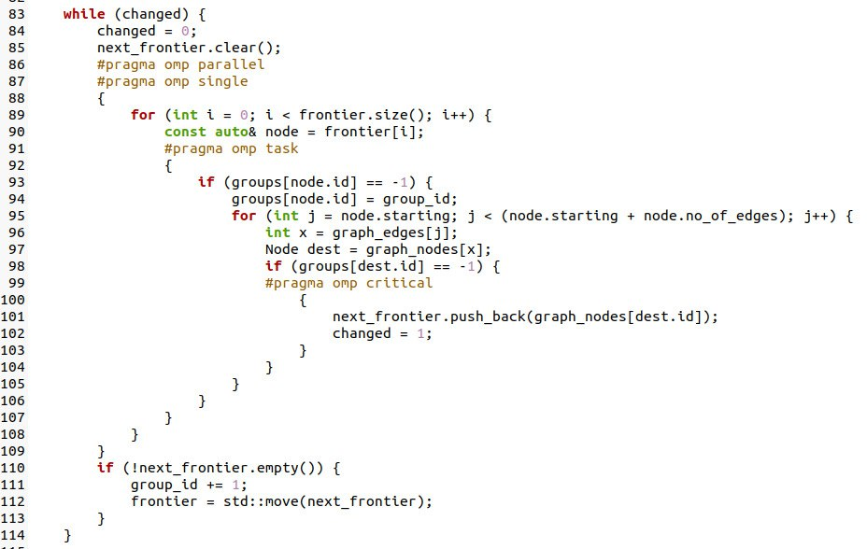
Parallel Code – First Version

Slide 24
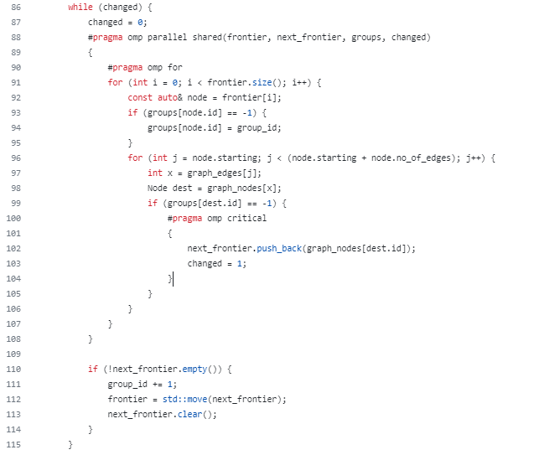
Parallel Code – Second Version

Slide 25
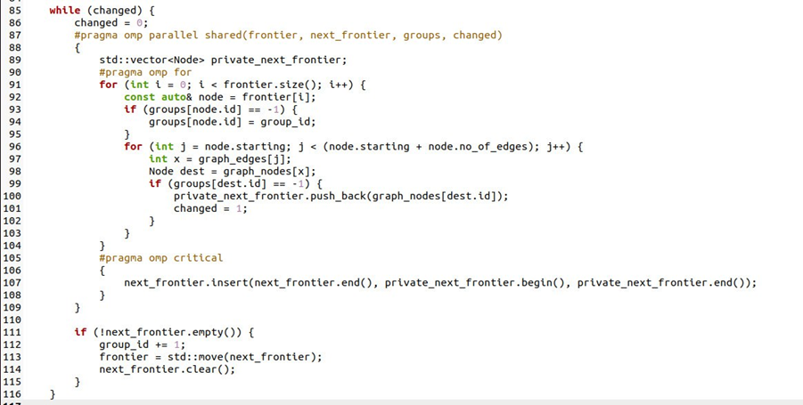
Parallel Code – Third Version

Slide 26
Conclusion
In conclusion, we learn how to write a code using openMP just by adding a few directives and instructions to the code. Implementing algorithms using openMP to increase the performance of the code by allowing to write parallel programs using different directives.

Slide 27
Thank You….

